Slide 1

Kharcha Track
Smart Expenses Tracker with Insights
By REMAN BUDDHACHARYA

Slide 2
Introduction
KharchaTrack is a smart expense tracker designed to help users efficiently manage their finances.
It allows users to record, analyze, and forecast expenses using intelligent insights.
Built with Laravel, Livewire, and PHP-ML, the system offers real-time tracking and data-driven decision-making.

Slide 3
Problem Statement
Many people struggle with unplanned spending and lack of financial insights.
Traditional expense trackers only log transactions but don’t provide future predictions or fraud detection.
Users need a smarter system that not only tracks but also predicts spending patterns and alerts them to anomalies.

Slide 4
Objective
Provide users with real-time insights, budget recommendations, and fraud detection alerts to improve financial decision-making.

Slide 5






Technology Used
Frontend
Development Tools
Livewire, MaryUI
PHPStorm, Laravel Herd
Operating System
Browser
Backend
Data Base
PHP, Laravel
MySql
Notes:
Livewire: Framework of larabell MarryUI: Codes Can be directly used

Slide 6
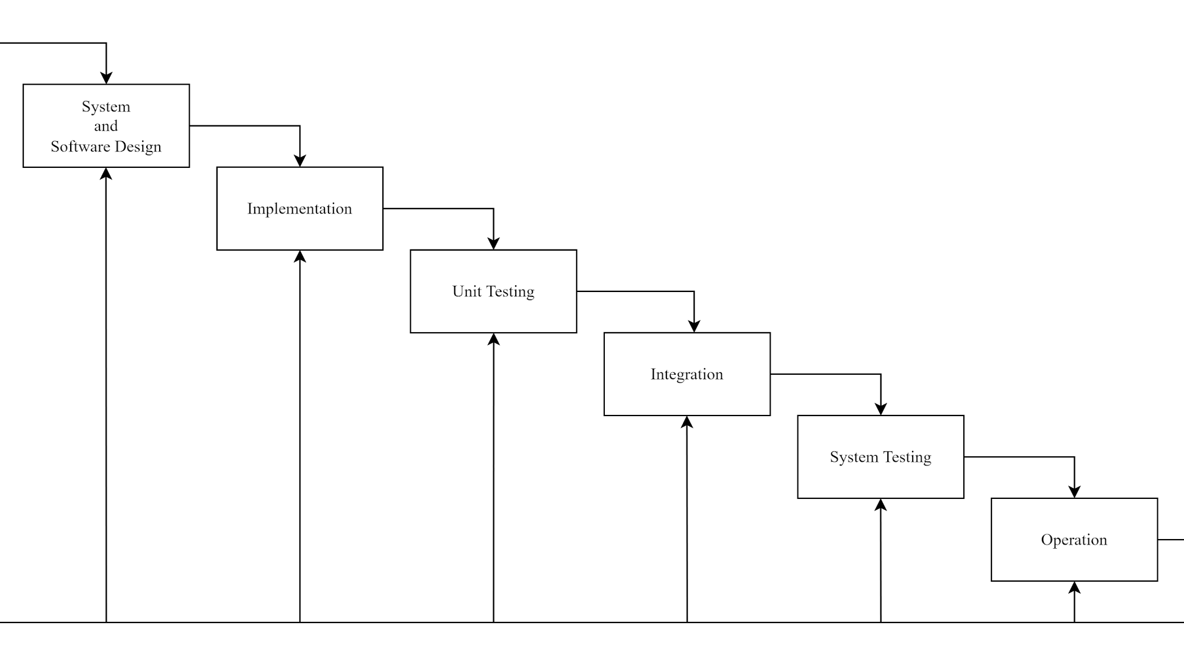
Methodology
Waterfall model
Linear approach suitable for defined requirements
Notes:
Given the defined requirements, we felt the Waterfall model would suit this linear project well.

Slide 7
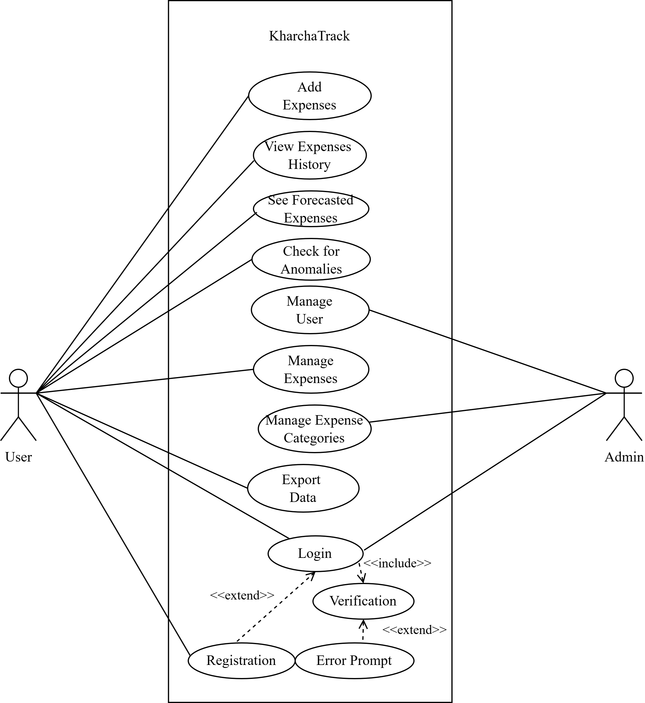
Architecture
USE CASE DIAGRAM

Slide 8
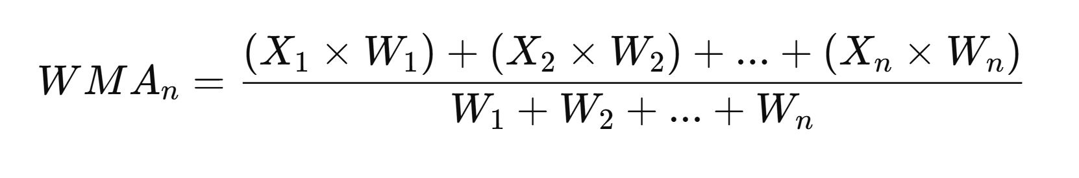
Description of Algorithm
Weighted Moving Average Algorithm (Expense Forecasting)
This algorithm calculates the average of past expenses over a specific period to predict future spending trends.
It helps users anticipate upcoming expenses based on their historical financial data.

Slide 9
Description of Algorithm
Isolation Forest Algorithm
(Anomaly Detection)
A machine learning algorithm used to identify outliers in financial transactions.
It detects suspicious or unusual expenses by isolating anomalies from normal spending patterns.
Useful for fraud detection, preventing overspending, and identifying financial irregularities.

Slide 10
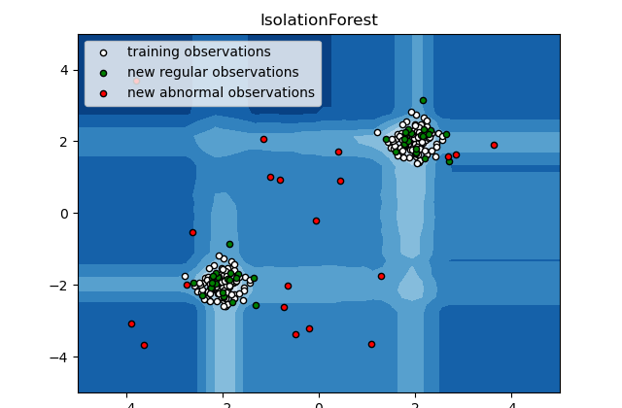
Isolation Forest Algorithm (Anomaly Detection)
Regular occurring expenses are clustered together.
Abnormal expenses are scattered.

Slide 11
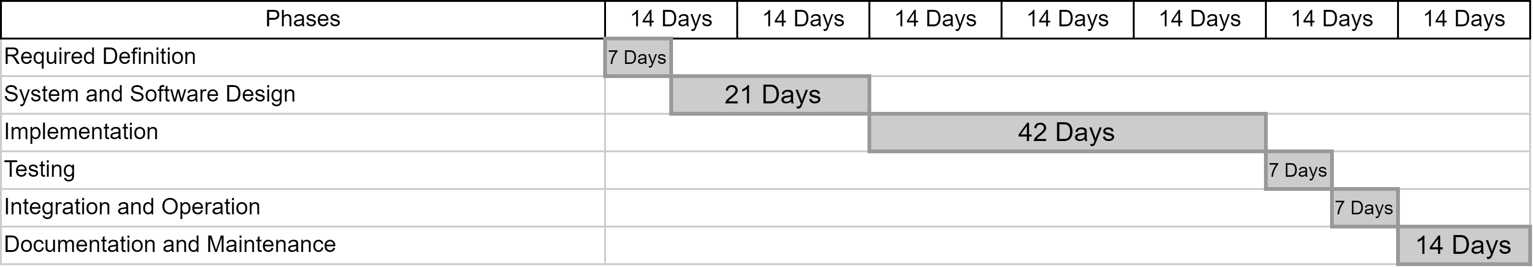
Gantt Chart

Slide 12

Expected Outcome
Users will be able to track their expenses easily and get predictions for future spending. The system will help users manage their budgets better and save more by spotting spending trends. By detecting unusual transactions, the system will help users identify fraud and reduce financial risks.

Slide 13
Thank You
Any queries?

